Slide 1
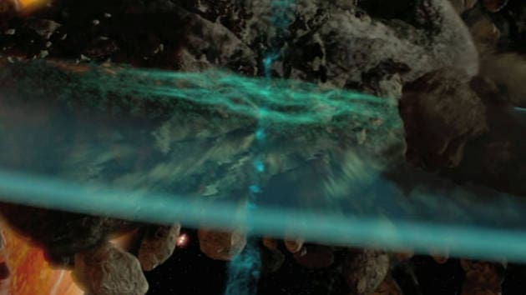
Star wars TM seismic charge CGP SHADER MINI-PROJECT
Tonko Bossen
Aalborg University, Medialogi 5
2. dec. 2022
Github repository: https://github.com/tbosse20/cgp_mini_project
Notes:
https://www.starwars.com/video/seismic-charges

Slide 2
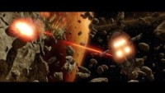

Slide 3


Slide 4


Slide 5
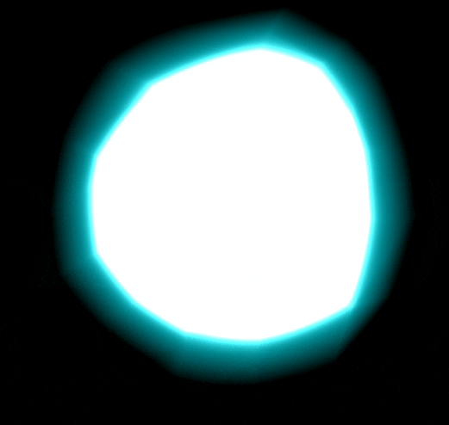
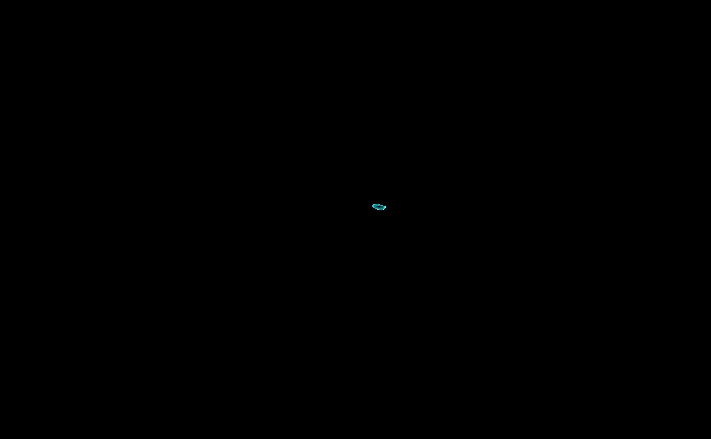
3 major elements
Bloom glimt
Smoke & cones wind-up
Disc expanding
Clipping depended to size and positive/negative values

Slide 6
Bloom glimt
Relative distance to camera
Scale relative alpha and highlighted color fresnel

Slide 7
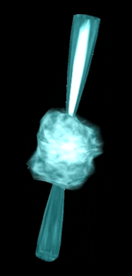
Smoke wind-up
Scale relative distortion using noise texture
Alpha and highlighted color fresnel
Smoke layering using noise texture
Flashing using hard noise texture

Slide 8
Cones wind-up
Fixed length and cut off
Curvature using normal and sin of y-values
Inner fresnel

Slide 9
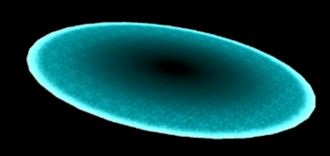
Disc expanding
Texture highlighting
Subtle intensity animation
White light outer rim
Fade out after specific size

Slide 10

Relative distance to camera

Slide 11
Relative distance to camera
float dist = min(abs(unity_ObjectToWorld) * 1000,
length(ObjSpaceViewDir(v.vertex)) * 2);

Slide 12
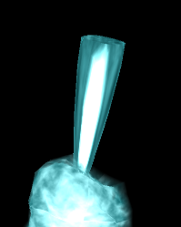
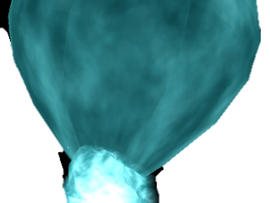
Cone curvature and cut off

Slide 13
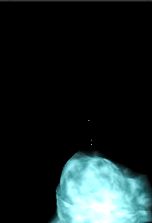
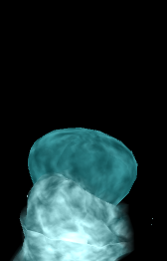
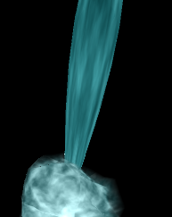
Cone curvature and cut off
v.vertex.y = min(.3, v.vertex.y); // Sharp cut ends (postive)
v.vertex.y = min(.3, -v.vertex.y); // Sharp cut ends (negative)
v.vertex.y *= (1 / length(unity_ObjectToWorld._m01_m11_m21)) * 10; // Fixed
v.vertex.xz = sin(v.vertex.y) * v.normal.xz; // Curve outgoing
v.vertex.xz *= .05 * length(unity_ObjectToWorld._m01_m11_m21); // Thicken realtive to size

Slide 14
Cone curvature and cut off
v.vertex.y = min(.3, v.vertex.y); // Sharp cut ends (postive)
v.vertex.y = min(.3, -v.vertex.y); // Sharp cut ends (negative)
v.vertex.y *= (1 / length(unity_ObjectToWorld._m01_m11_m21)) * 10; // Fixed
v.vertex.xz = sin(v.vertex.y) * v.normal.xz; // Curve outgoing
v.vertex.xz *= .05 * length(unity_ObjectToWorld._m01_m11_m21); // Thicken realtive to size

Slide 15
Cone curvature and cut off
v.vertex.y = min(.3, v.vertex.y); // Sharp cut ends (postive)
v.vertex.y = min(.3, -v.vertex.y); // Sharp cut ends (negative)
v.vertex.y *= (1 / length(unity_ObjectToWorld._m01_m11_m21)) * 10; // Fixed
v.vertex.xz = sin(v.vertex.y) * v.normal.xz; // Curve outgoing
v.vertex.xz *= .05 * length(unity_ObjectToWorld._m01_m11_m21); // Thicken realtive to size

Slide 16
Cone curvature and cut off
v.vertex.y = min(.3, v.vertex.y); // Sharp cut ends (postive)
v.vertex.y = min(.3, -v.vertex.y); // Sharp cut ends (negative)
v.vertex.y *= (1 / length(unity_ObjectToWorld._m01_m11_m21)) * 10; // Fixed
v.vertex.xz = sin(v.vertex.y) * v.normal.xz; // Curve outgoing
v.vertex.xz *= .05 * length(unity_ObjectToWorld._m01_m11_m21); // Thicken realtive to size

Slide 17
Cone curvature and cut off
v.vertex.y = min(.3, v.vertex.y); // Sharp cut ends (postive)
v.vertex.y = min(.3, -v.vertex.y); // Sharp cut ends (negative)
v.vertex.y *= (1 / length(unity_ObjectToWorld._m01_m11_m21)) * 10; // Fixed
v.vertex.xz = sin(v.vertex.y) * v.normal.xz; // Curve outgoing
v.vertex.xz *= .05 * length(unity_ObjectToWorld._m01_m11_m21); // Thicken realtive to size

Slide 18
Bloom / Fresnel

Slide 19
Bloom / fresnel Camera view and normals

Slide 20
Bloom / fresnel Dot product
0 =
-0.7 =
-1 =

Slide 21
Bloom / fresnel Result

Slide 22
Bloom / fresnel Highlighted

